Slide 1
ICT Computing Lesson 4:
Computing Network

Slide 2
Objectives
1.4.1: Define “network,” and give examples of networks used at home, school and work.
1.4.2: Compare types of networks, including LAN, WAN, MAN, VPN, intranet, extranet, the Internet.
1.4.4: Compare various network models and their advantages, including client/server, mainframe/terminal, peer-to-peer.
1.4.5: Compare various methods and media for network connections, including broadband, wireless, Bluetooth, cellular, satellite.
1.4.6: Describe the functions of various network hardware devices, including NIC, hub, switch, router, bridge, gateway, access point.
1.4.7: Describe the purpose of protocols, and identify the protocols commonly used in networks, including TCP/IP, DHCP, DNS, HTTP, FTP, IMAP, POP, SMTP.
1.4.8: Describe the purpose and function of IP addressing, and distinguish between public and private IP addresses.

Slide 3
Network
Two or more computers are connected to form a network

Slide 4
Network Types
Network Type | Description | Best use
Local area network (LAN) | A group of connected computers confined within a small geographic area LANs can range in size and scale based on their use | Examples include a home network, a school's network or a small office's network Many homes and businesses use wireless local area networks (WLANs) to provide wireless connectivity within a small geographic area
Metropolitan area network (MAN) | Designated for a network connection within a large city or multiple small cities A MAN is much larger than a LAN because it covers a large geographic area | MANs are commonly operated by local governments or private companies
Wide area network (WAN) | The largest network type Connects two or more LANs together A WAN is typically owned and maintained by the owner of the LANs that it connects The largest WAN in existence is the Internet | Large corporations that span multiple cities, states or countries

Slide 5
Types of Networks
Intranet: designed for a companies employees to share internal information
Can not be accessed by anyone without company permission and a user/password assigned by the company
Extranet: similar to a Intranet, but is usually designed for the companies customers to also access
Virtual Private Network: secure networks designed to allow access to a specific group of people

Slide 6
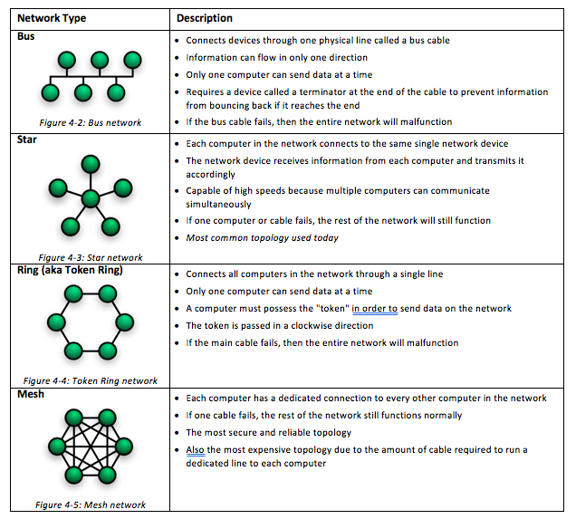
Network Topology
How the network is designed to share information

Slide 7
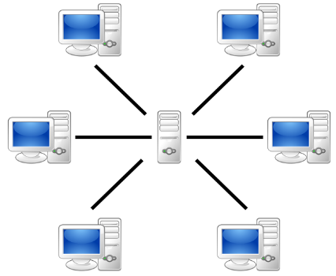
Client / Server Network Model
Clients are all connected to a server, or multiple servers
Client: end user’s computer – processes the information
Server: a powerful computer that stores information and processes requests from the connected clients
file sharing
print sharing
e-mail

Slide 8
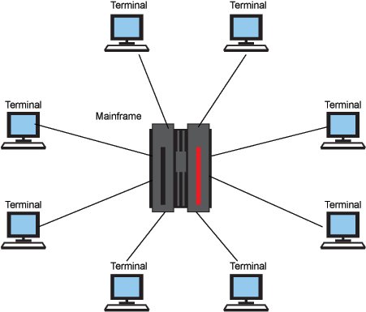
Mainframe / Terminal Network Model
Mainframe computer runs all programs directly on the mainframe
Terminal: an access point to the mainframe that provides a connection for a keyboard, mouse and monitor
Is not an actual computer and cannot process the information

Slide 9
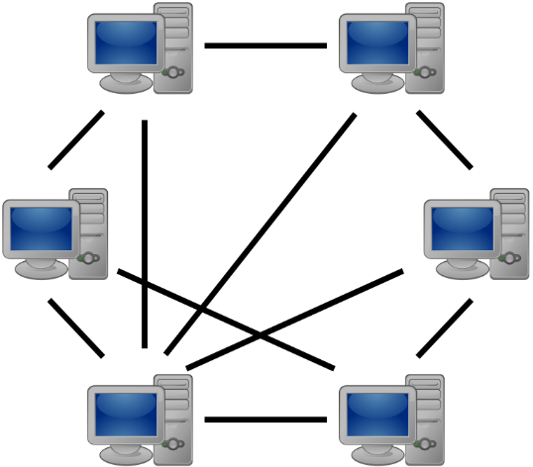
Peer to Peer Network Model
Clients are attached to each other to share files or printers
There is no server

Slide 10
Requirements to Connect to a Network
Computer(s) — desktop, notebook, tablet, mobile device
Operating system — Windows, Linux, Mac OS, mobile OS
Network media — wired or wireless connections
Network hardware — physical hardware connecting computers across the network
Network protocol — the set of rules defining how the computers on the network will communicate

Slide 11
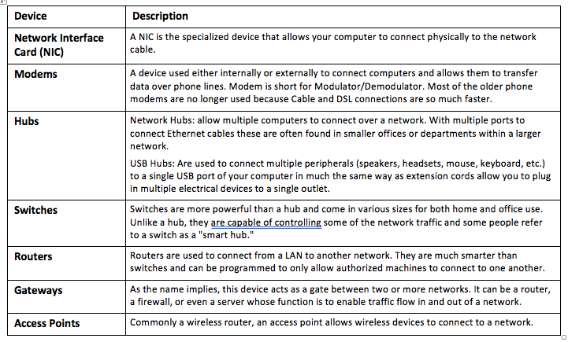
Network Hardware

Slide 12
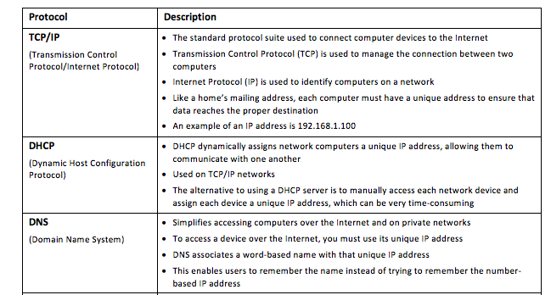
Network protocols: Rules for connecting and transmitting information

Slide 13
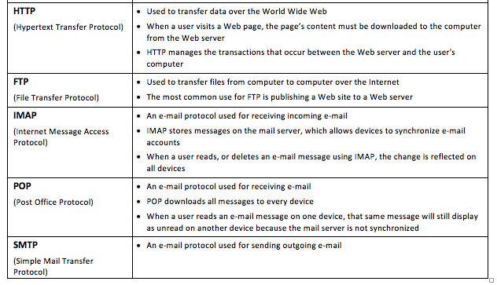
Network protocols: Rules for connecting and transmitting information

Slide 14
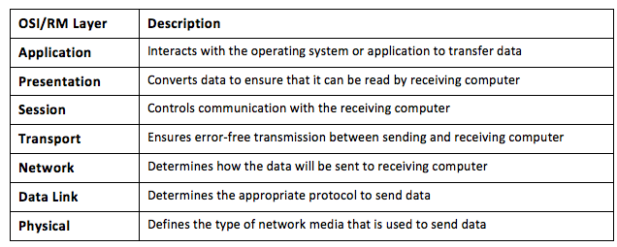
Open Systems Interconnection (OSI)
Standardize the way that computers communicate with one another
Divides a computer’s communication into seven layers

Slide 15
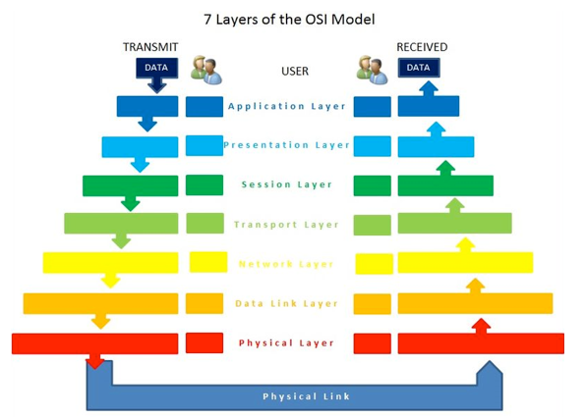
Flow Information OSI Model

